Slide 1

IST722 Data Warehousing
Technical Architecture
Michael A. Fudge, Jr.
* Figures taken from Kimball Ch. 4

Slide 2
Objective:
Understand the technical architecture required by the data warehouse.

Slide 3
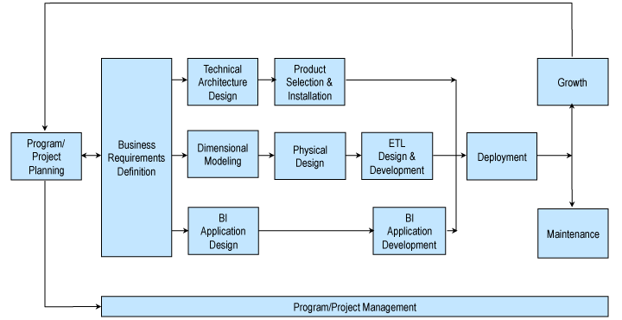
Recall: Kimball Lifecycle
Notes:
Describes an approach for data warehouse projects

Slide 4
Architecture != Infrastructure
Technical Architecture
Technical Infrastructure
A Framework of rules, decisions, and structures for the overall design of a system.
A physical means of implementing a technical architecture through hardware and software.
It’s how we Conceptualize the Data Warehouse is built!

Slide 5
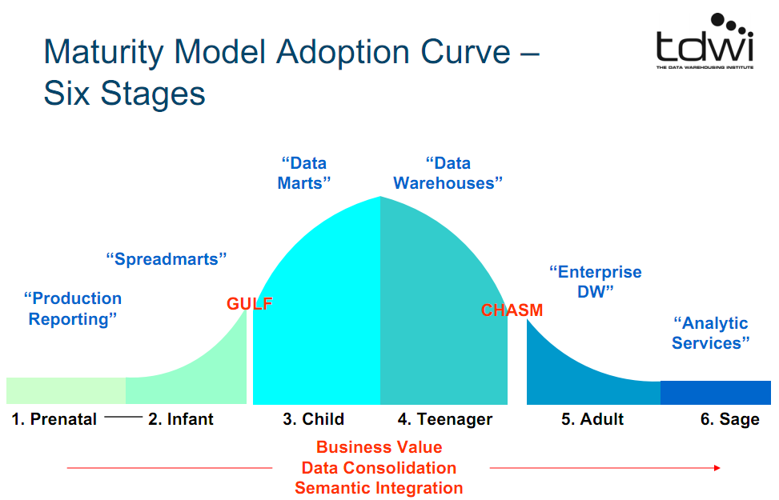
The Data Warehouse Maturity Model
Technical
Architecture
Must be
addressed
At GULF
And CHASM

Slide 6
5 Technical Architectures
We must choose a technical architecture to mature our data warehouse.
Independent Data Marts
Enterprise Bus Architecture
Hub And Spoke
Centralized
Federated

Slide 7
Independent Data Marts
Ad hoc “grassroots” technical architecture
Departmentalized, lacking enterprise focus.
No Consistency or data integration
Do not share dimensions
Data is sourced independently.
External World
Payroll
Sales
Inventory
Forecasting

Slide 8
Enterprise Bus Architecture
Kimball Technical Architecture
Enterprise Focus
Consistent
Conformed Dimensions (reused)
Data is sourced systematically
External World
Stage
Data Warehouse: Dimensions &
Fact Tables

Slide 9
Hub And Spoke
Inmon Technical Architecture
Enterprise Focus
Data warehouse does not have Dimensional Models, but time variance.
Data Sourced Systematically
Dimensional Models in Data Marts
External World
Stage
Data Mart
Data Warehouse: 3NF + Time Variance, MDM
Data Mart
Data Mart

Slide 10
Centralized Data Warehouse
Similar to Hub and Spoke but without the dependent data marts.
Contains Atomic Data, Summarized data, time-variant data, and Dimensional Models
External World
Stage
Data Warehouse: 3NF + Time Variance, MDM, Dimensional Models

Slide 11
Federated Data Warehouse
Most Complex
Service-oriented Architecture
Used to integrate existing Data Marts, Warehouses and legacy applications into a single logical data warehouse.
Data Warehouse
Data Warehouse
Data Warehouse

Slide 12
Which Technical Architecture?
Urgent need?
MDM Strategy?
Need to Integrate existing data warehouses?
Grow organically?
Simplified enterprise Focus?

Slide 13
Which Technical Architecture?
Urgent need?
MDM Strategy?
Need to Integrate existing data warehouses?
Grow organically?
Integrated Data-Mart Focus?
Independent Data Marts
Hub-And-Spoke
Federated Architecture
Centralized Data Warehouse
Enterprise Bus

Slide 14
✓ Check Yourself ✓
KIMBALL TECHNICAL ARCHICETURE
What Kimball mean by:
“front room architecture”?
“back room architecture”?
What are the 3 main system architectures of the model?
?
?
?

Slide 15
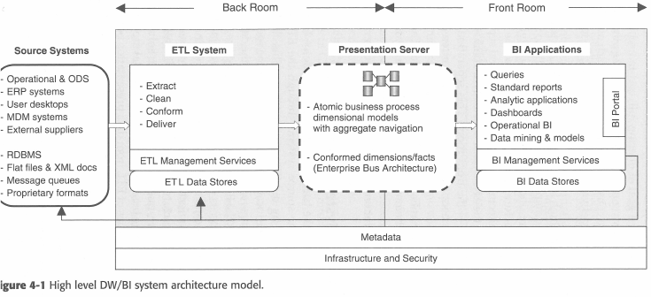
Kimball: DW/BI System Architecture Model
* Figure 4-1 from Kimball text
Notes:
Back room - hidden from end-user
Front room – user interacts with these components

Slide 16
Back Room and Front Room Architectures
Back Room
Front Room
Behind the scenes.
No direct interaction with the business users.
Business users see and interact with this architecture.

Slide 17
3 System Architectures
Back-Room: ETL System (We’ll cover this next class)
Back-Room and Front Room: Presentation Server (We’ve covered this already)
Front-Room: BI Applications (We’ll cover this in 2 classes)

Slide 18
Metadata
The information that describes our technical architecture.
Spans all 3 System Architectures: Back, Presentation & Front.
Technical Metadata – Infrastructure oriented. Indexes, table partitions, data types, data transformations.
Business Metadata – User oriented. Data structure definitions, Data dictionaries, implicit data hierarchies.
Process Metadata – System oriented. Performance metrics and measurements. The Audit Dimension.

Slide 19
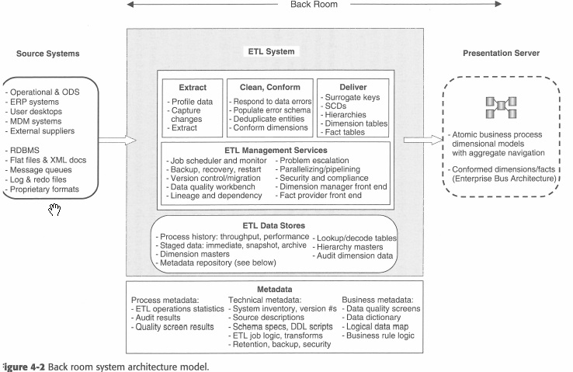
Back Room Architecture
Behind the scenes.
No direct interaction with the business users.
ETL System + Parts of the Presentation Server

Slide 20
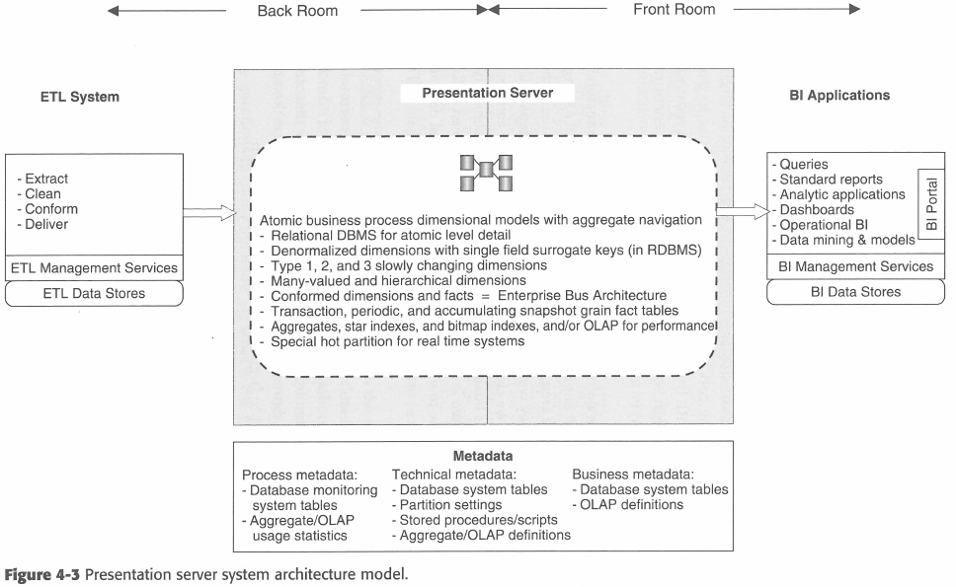
Presentation Server Architecture
Dimensional Models as ROLAP Star Schemas, MOLAP Cubes
Enterprise Bus Architecture
Conformed Dimensions across fact tables.

Slide 21
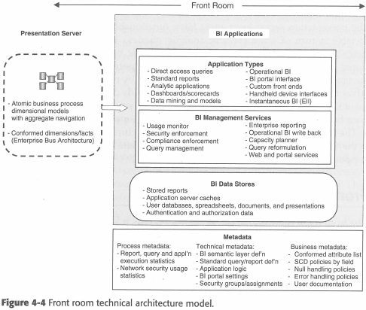
Front-Room Architecture
Business users see and interact with this architecture.
Business Intelligence
Reports, Cube Explorers, Data mining, Dashboards, Scorecards.

Slide 22
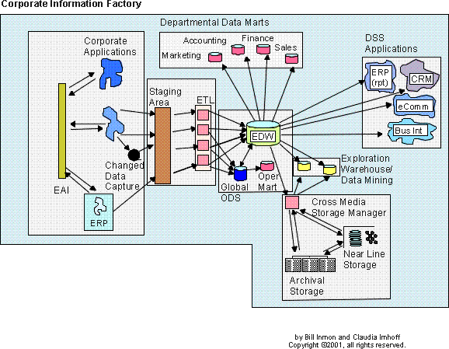
Kimball v Inmon
Compare and contrast to the CIF:
Front / Back Room?
ETL / PS / BI?
Similarities?
Differences?

Slide 23
Kimball v Inmon
Compare and contrast to the CIF:
Front Room
Presentation
Back Room
Similarities?
Differences?

Slide 24
A Closing Group Activity - More Product Evals!
Research the following products.
What does it do?
How does it fit within the Kimball architecture?
Front room?
Presentation Server?
Back Room?
Do you need your own infrastructure?
Three Products:
Board (http://www.board.com)
Snaplogic (http://www.snaplogic.com)
Spark (https://spark.apache.org)
Take 18 Minutes!

Slide 25
IST722 Data Warehousing
Technical Architecture
Michael A. Fudge, Jr.

